Slide 1
Linear Discriminant Analysis How to use it as a classifier
How LDA combines variables
Find an appropriate cutoff value
Calculate sensitivity and specificity and how to generate an ROC curve
Validation
Classify with more than two groups

Slide 2
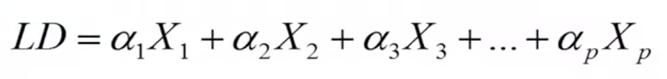
LDA
LDA is a method that aims to maximize the separation between two or more groups.

Slide 3
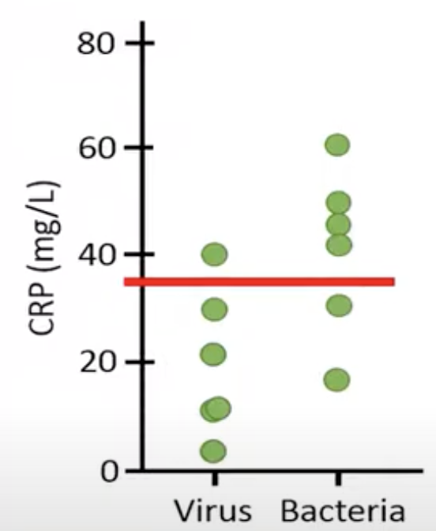
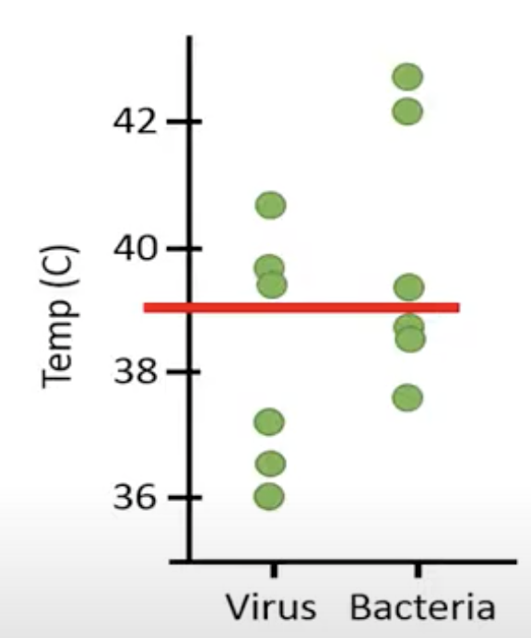
Example data – combine variables
Infection | CRP(mg/L) | Temp (C)
Viral | 40 | 36
Viral | 11.1 | 37.2
Viral | 30 | 36.5
Viral | 21.4 | 39.4
Viral | 10.7 | 39.6
Viral | 3.4 | 40.7
Bacterial | 42 | 37.6
Bacterial | 31.1 | 42.2
Bacterial | 50 | 38.5
Bacterial | 60.4 | 39.4
Bacterial | 45.7 | 38.6
Bacterial | 17.3 | 42.7
Notes:
The data contains information on 12 patients.
The method combines variables, so that the linear combination has a maximal separation between the groups. To achieve maximal separation, it finds optimal values of these weights. LDA will put more weights on variables that are good in separating the groups. The blood concentration of the c-reactive protein as well as the body temperature have been measured on 12 patients that have entered a hospital. Once the patients had entered the hospital, the presence of bacteria and viruses were analyzed from different samples. However, it usually takes several hours or days to determine if a patient has a viral infection or a bacterial infection. After 2 days at the hospital, these 6 patients were found to be infected by a virus whereas these 6 patients were confirmed to have a bacterial infection. Since antibiotics are only effective on bacteria , only these patients were treated with antibiotics.
The problem is that we have to wait about 2 days to confirm the type of pathogen. Therefore, we need to wait 2 days know if antibiotic treatment is appropriate or not. It would be great if we could use the CRP concentration or the body temperature to tell if a patient has a bacterial or viral infection because the measurements of these variables can be done within just 1 hour.
If we plot the CRP concentration of the 12 patients, we see that no simple cutoff line can be used to separate the ones with a bacterial infection from the ones with a viral infection.
The same is also true for the body temperature, because we can’t separate the patients with a bacterial infection from the patients with a viral infection by using only the body temperature.

Slide 4
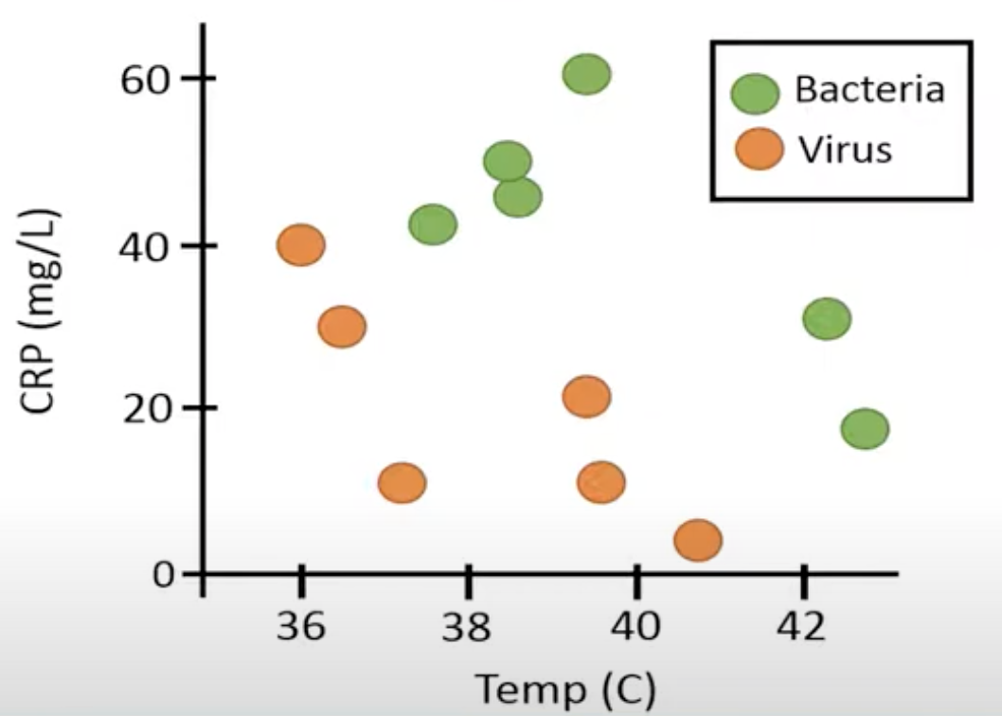
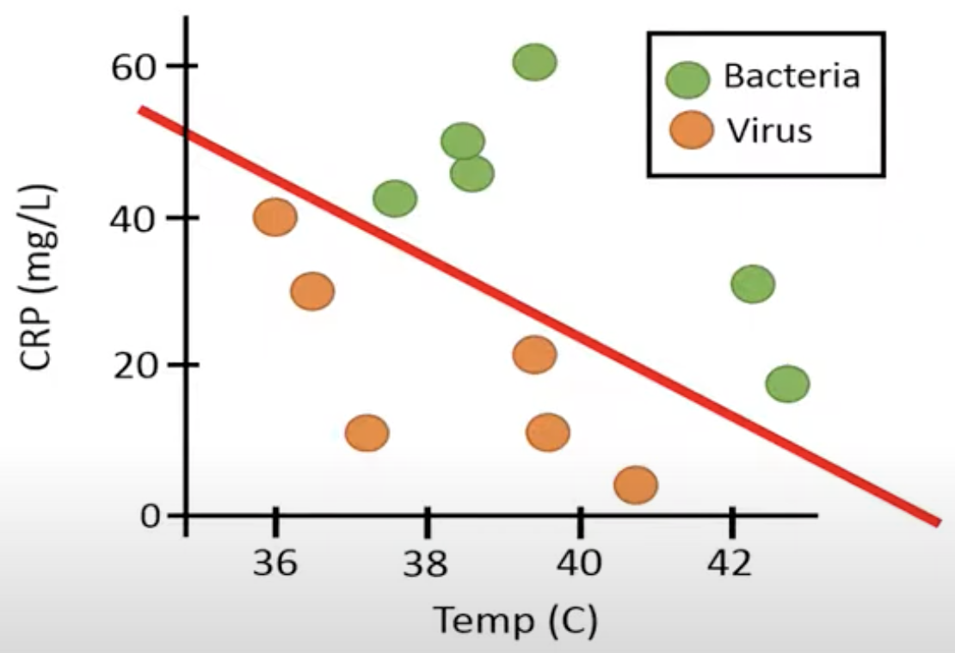
LDA – cutoff value
Separate the 2 groups completely
Notes:
However, if we plot the CRP concentration and the body temperature in the same plot and use different colors for patients with a viral infection and bacterial infection.
We can see that the line can separate the 2 groups completely. This indicates that LDA would do a good job in separating the groups by combining the 2 variables.
Just as PCA, LDA can be seen as we rotate the data into 2 new dimensions, which are here called discriminant function 1 and 2.

Slide 5
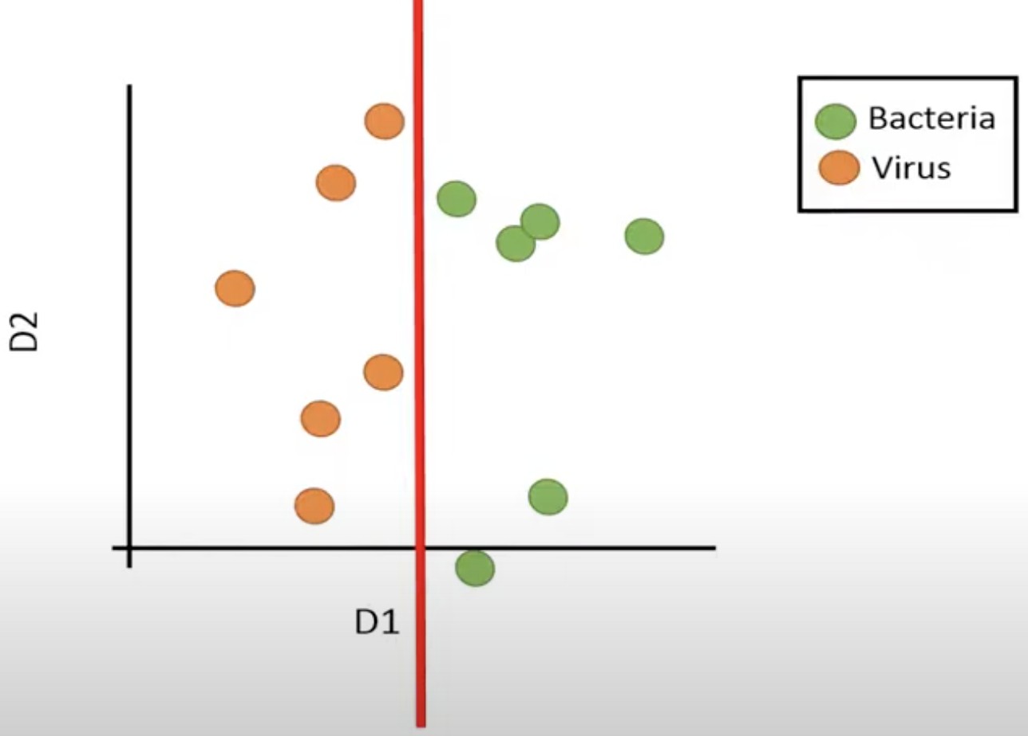
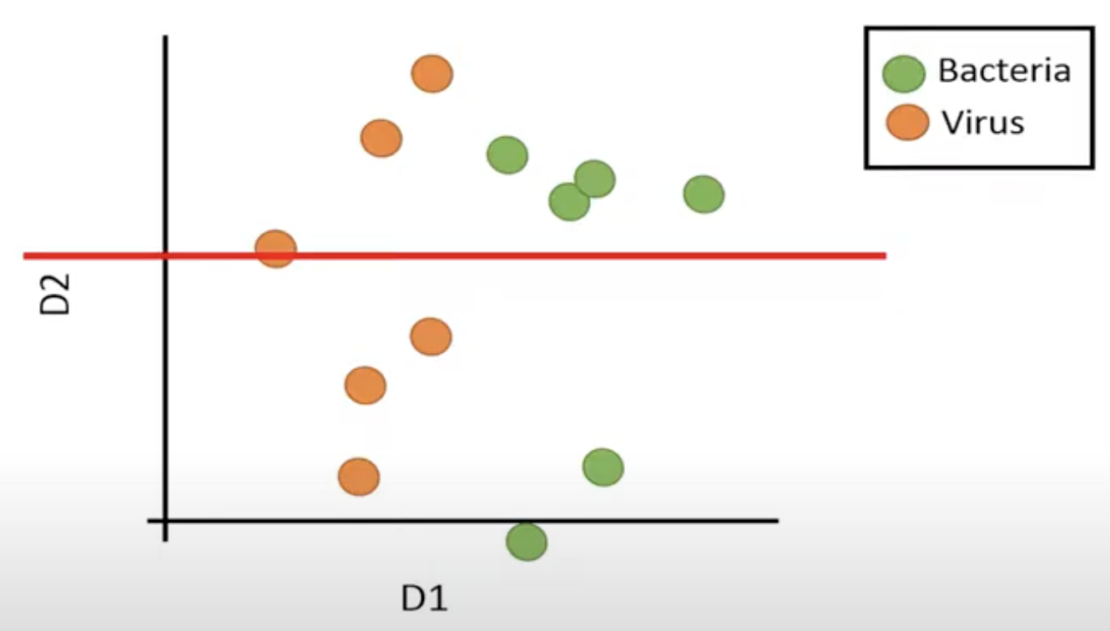
LDA – cutoff value
The first discriminant function can be used to separate the two groups perfectly.
The second discriminant function is not useful for separation.
Notes:
We can see that the first discriminant function can be used to separate the two groups perfectly. In contrast, we can’t see separate the groups based on a horizontal line, which means that the second discriminant function is not useful for separation.

Slide 6
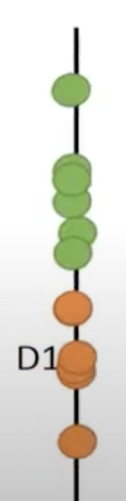
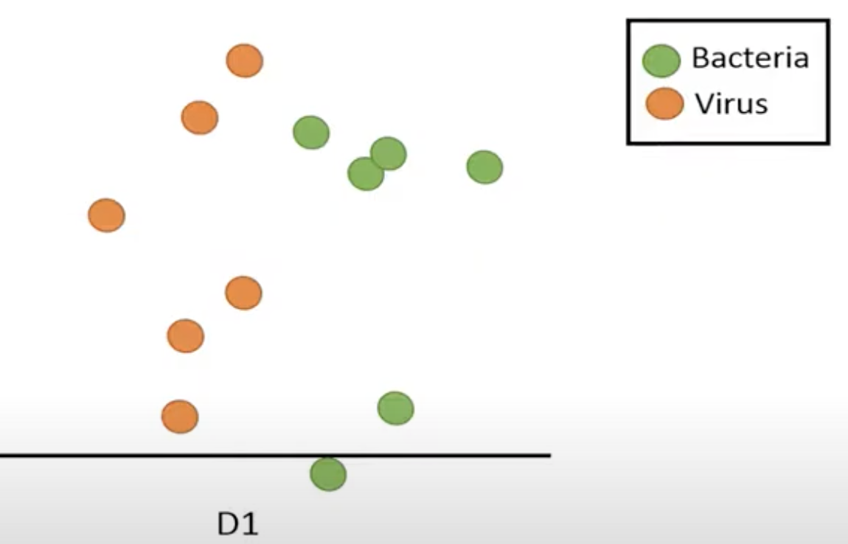
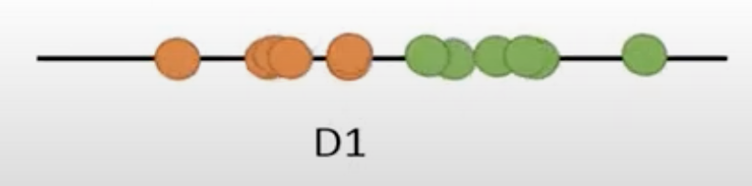
LDA
The data points are plotted vertically
Delete the second discriminant function
Place all data points on just one line
Notes:
Therefore, we can delete the second discriminant function and place all data points on just one line. We rotate the plot so that the data points are plotted vertically

Slide 7
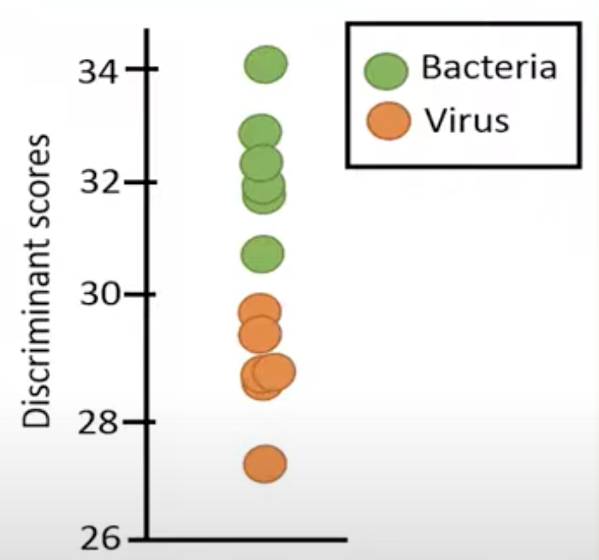
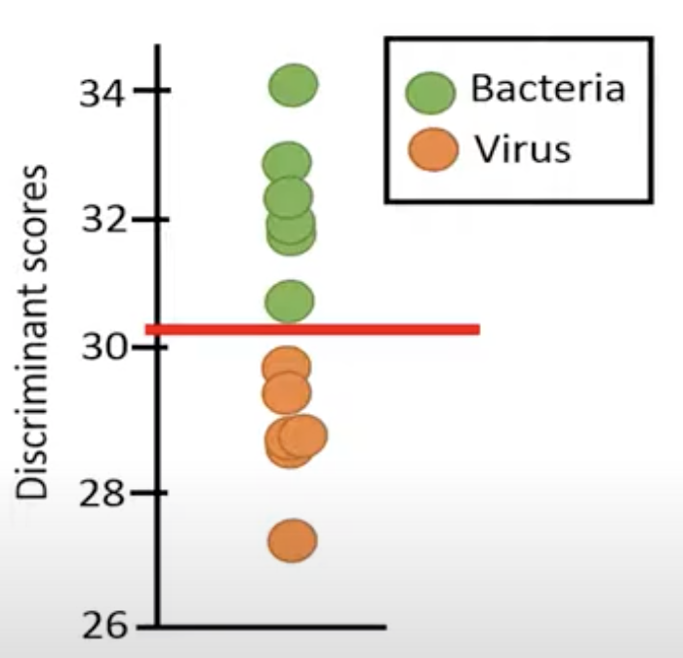

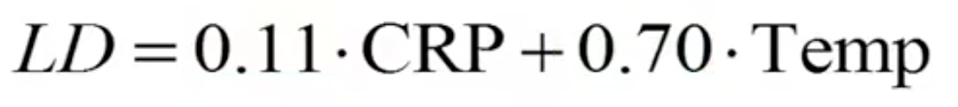
LDA
Cut-off
Notes:
If we use LDA, we can plot the so-called discriminant scores like this. We can place a cut-off value like this that gives us a perfect separation between 2 groups. By using LDA we have combined the two variables, CRP and body temperature in a way that has maximized the separation between the two groups.
The linear discriminant scores in this plot can be obtained by this equation. We can replace X1 and X2 with the variable names CRP and Temp.
The values of the weights , alpha 1 and alpha 2, were computed with a statistical software to 0.11 and 0.7. These values give us the optimal separation between the groups.

Slide 8
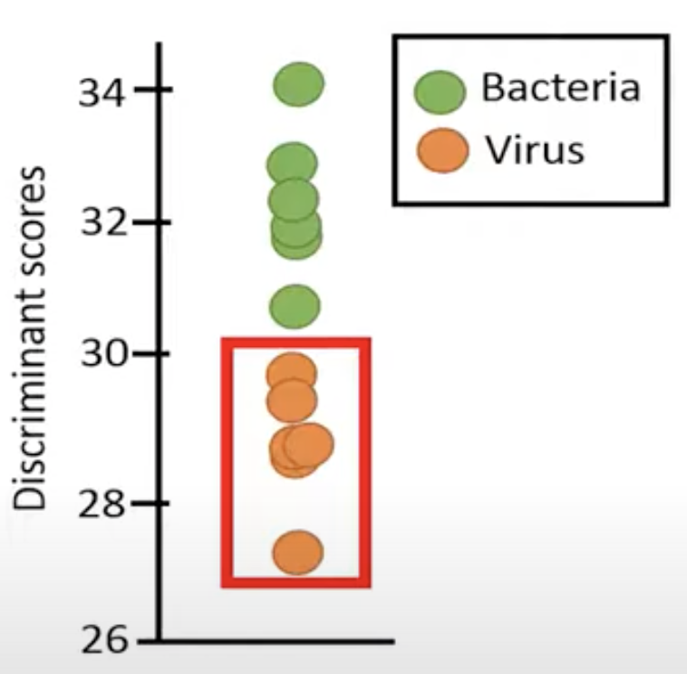
Calculate the scores
Infection | CRP(mg/L) | Temp (C) | Scores
Viral | 40 | 36 | 29.5
Viral | 11.1 | 37.2 | 27.3
Viral | 30 | 36.5 | 28.8
Viral | 21.4 | 39.4 | 29.9
Viral | 10.7 | 39.6 | 28.9
Viral | 3.4 | 40.7 | 28.9
Bacterial | 42 | 37.6 | 30.8
Bacterial | 31.1 | 42.2 | 32.9
Bacterial | 50 | 38.5 | 32.3
Bacterial | 60.4 | 39.4 | 34
Bacterial | 45.7 | 38.6 | 31.9
Bacterial | 17.3 | 42.7 | 31.8
28.9
30.6 is a
good cut-off value
32.3
Notes:
Let’s use this equation to calculate the discriminant scores. We can see that the scores for the ones with a viral infection are lower compared to the ones who have a bacterial infection.
One way to find a good cut-off value is to calculate the means of the discriminant scores of each group. We see that the mean discriminant score of the viral group is 28.9 and 32.3 for the bacterial group, the mean of these two means is 30.6. We can see that 30.6 is a good cut-off value to use since it separates the two groups completely.

Slide 9
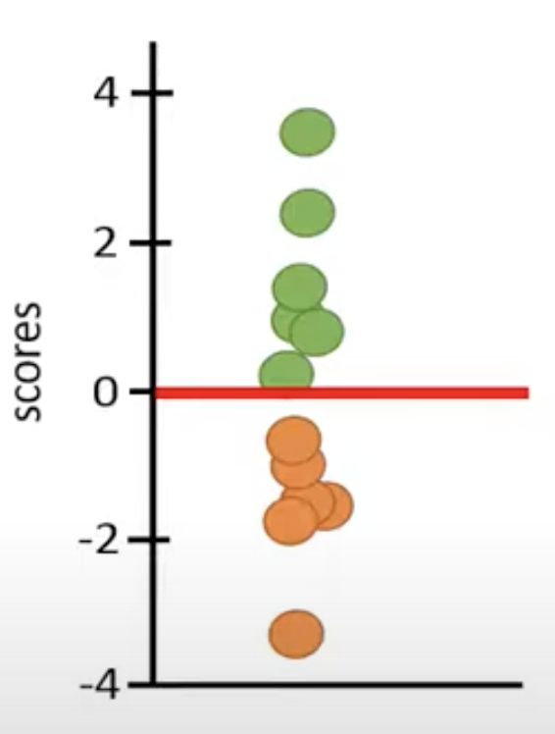

Calculate the centered scores
Infection | CRP(mg/L) | Temp (C) | Scores | Center scores
Viral | 40 | 36 | 29.5 | -1.1
Viral | 11.1 | 37.2 | 27.3 | -3.3
Viral | 30 | 36.5 | 28.8 | -1.8
Viral | 21.4 | 39.4 | 29.9 | -0.7
Viral | 10.7 | 39.6 | 28.9 | -1.7
Viral | 3.4 | 40.7 | 28.9 | -1.7
Bacterial | 42 | 37.6 | 30.8 | 0.2
Bacterial | 31.1 | 42.2 | 32.9 | 2.3
Bacterial | 50 | 38.5 | 32.3 | 1.7
Bacterial | 60.4 | 39.4 | 34 | 3.5
Bacterial | 45.7 | 38.6 | 31.9 | 1.3
Bacterial | 17.3 | 42.7 | 31.8 | 1.2
-1.71
0
1.71
Notes:
However, it is common to center the discriminant scores by first subtracting the means from the original values. By using this equation, the centered scores are calculated.
If we plot the centered scores, we can see that the scores center around zero since the mean of these scores is equal to 0. The means of these centered scores for the two groups are -1.71 and 1.71. The mean of these 2 means is equal to 0.
A reasonable cut-off value based on the centered scores is 0.

Slide 10
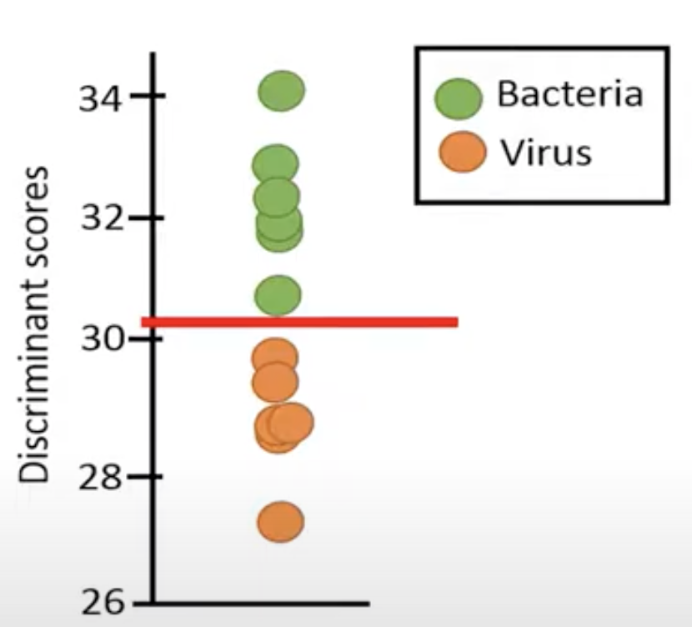
Sensitivity and specificity
Infection | CRP(mg/L) | Temp (C) | Scores
Viral | 40 | 36 | 29.5
Viral | 11.1 | 37.2 | 27.3
Viral | 30 | 36.5 | 28.8
Viral | 21.4 | 39.4 | 29.9
Viral | 10.7 | 39.6 | 28.9
Viral | 3.4 | 40.7 | 28.9
Bacterial | 42 | 37.6 | 30.8
Bacterial | 31.1 | 42.2 | 32.9
Bacterial | 50 | 38.5 | 32.3
Bacterial | 60.4 | 39.4 | 34
Bacterial | 45.7 | 38.6 | 31.9
Bacterial | 17.3 | 42.7 | 31.8
28.9
30.6 cut-off
32.3
Notes:
We see how to calculate sensitivity and specificity based on the predictions by the LDA model. Note that, we use the original scores to predict if a person has a bacterial or viral infection. We use cutoff 30.6, which is the mean of the two means.
A person with a discriminant score greater than 30.6, will be predicted to have a bacterial infection whereas a person with a discriminant score less than 30.6 will be predicted to have a viral infection.

Slide 11
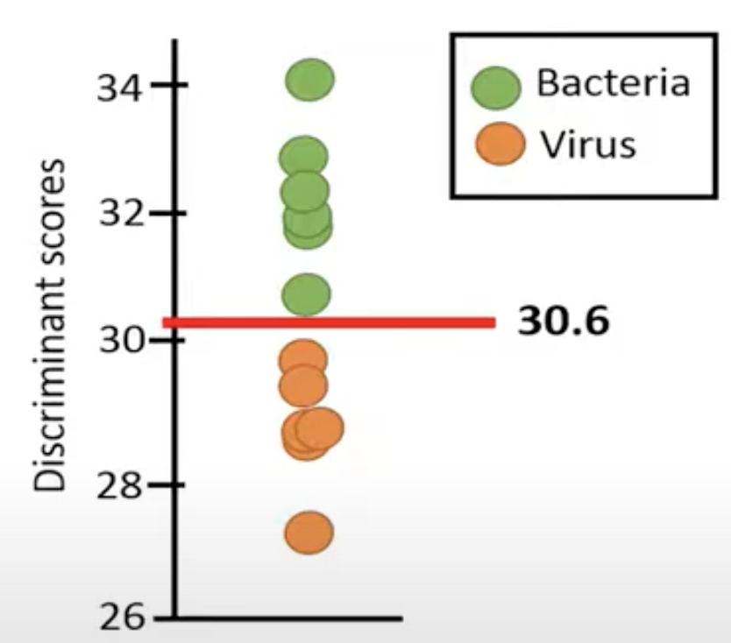
Sensitivity and specificity
Infection | CRP(mg/L) | Temp (C) | Scores | Predicted class
Viral | 40 | 36 | 29.5 | Viral
Viral | 11.1 | 37.2 | 27.3 | Viral
Viral | 30 | 36.5 | 28.8 | Viral
Viral | 21.4 | 39.4 | 29.9 | Viral
Viral | 10.7 | 39.6 | 28.9 | Viral
Viral | 3.4 | 40.7 | 28.9 | Viral
Bacterial | 42 | 37.6 | 30.8 | Bacterial
Bacterial | 31.1 | 42.2 | 32.9 | Bacterial
Bacterial | 50 | 38.5 | 32.3 | Bacterial
Bacterial | 60.4 | 39.4 | 34 | Bacterial
Bacterial | 45.7 | 38.6 | 31.9 | Bacterial
Bacterial | 17.3 | 42.7 | 31.8 | Bacterial
Notes:
Let’s add an additional column in the table that shows the predicted class based on LDA function. Since the discriminant scores for these first 6 individuals are less than 30.6, LDA predict that these individuals have a viral infection. And the discriminant scores are greater than 30.6, LDA predict that these individuals have a bacterial infection. We see that all individuals with a viral infection are correctly predicted by LDA to have a viral infection and the same with bacterial infection.

Slide 12
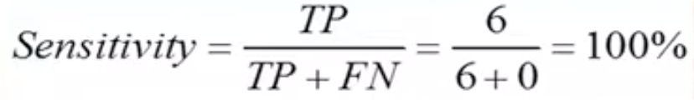
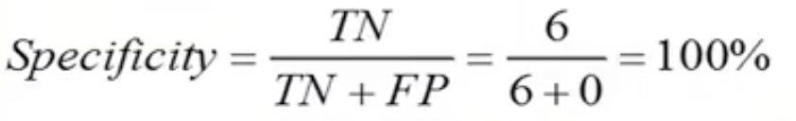
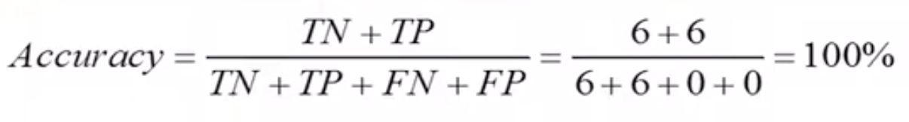
Sensitivity and specificity
Infection | CRP(mg/L) | Temp (C) | Scores | Predicted class
Viral | 40 | 36 | 29.5 | Viral
Viral | 11.1 | 37.2 | 27.3 | Viral
Viral | 30 | 36.5 | 28.8 | Viral
Viral | 21.4 | 39.4 | 29.9 | Viral
Viral | 10.7 | 39.6 | 28.9 | Viral
Viral | 3.4 | 40.7 | 28.9 | Viral
Bacterial | 42 | 37.6 | 30.8 | Bacterial
Bacterial | 31.1 | 42.2 | 32.9 | Bacterial
Bacterial | 50 | 38.5 | 32.3 | Bacterial
Bacterial | 60.4 | 39.4 | 34 | Bacterial
Bacterial | 45.7 | 38.6 | 31.9 | Bacterial
Bacterial | 17.3 | 42.7 | 31.8 | Bacterial
Positive test result = bacterial infection
Negative test result = viral infection
Notes:
Let’s decide a bacterial infection is associated with a positive test result, whereas a viral infection is associated with a negative test result. Note that the selection, in this case, is arbitrary in this example since we don’t have disease vs healthy. Since the bacterial infection is associated with a positive test result, we have 6 true positives and no false negatives.
Remember that the sensitivity is how often the test shows a positive result out of the ones who have the disease, which is defined as having a bacterial infection. Since all patients with a bacterial infection are correctly predicted, the sensitivity is in this example 100%. Remember that the specificity is how often the test shows a negative result out of the ones who don’t have the disease, which in this example represents the ones with a viral infection. Since all patients with a viral infection are correctly predicted, we have 6 true negatives no false positives, which result in a specificity of 100%.
We can calculate the accuracy. Since all patients are correctly predicted, the accuracy is 100%,

Slide 13
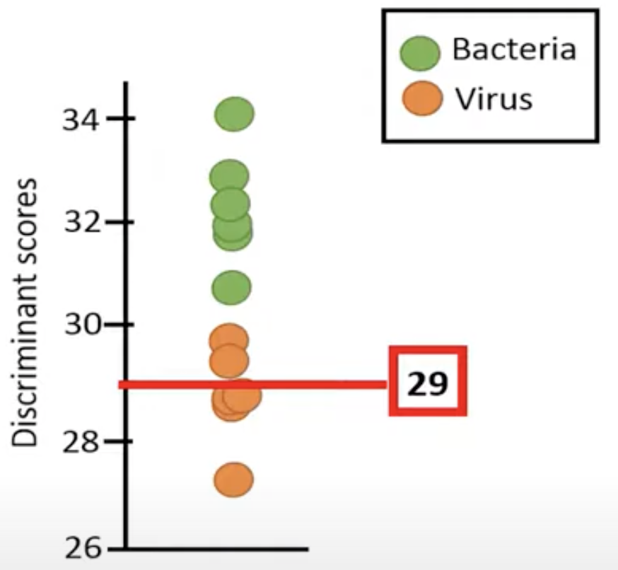
Change the cutoff value
Notes:
Note that we can change the cutoff value depending on if we think that the sensitivity is more important than the specificity. If we like to be more certain to detect all bacterial infections to future data, we could use the lower cutoff value. By using a cutoff value at 29, we will be more confident that we identify all patients with bacterial infections and treat these with antibiotics. However, it means that some patients with a viral infection will be predicted to have a bacterial infection and will incorrectly be treated with antibiotics.

Slide 14
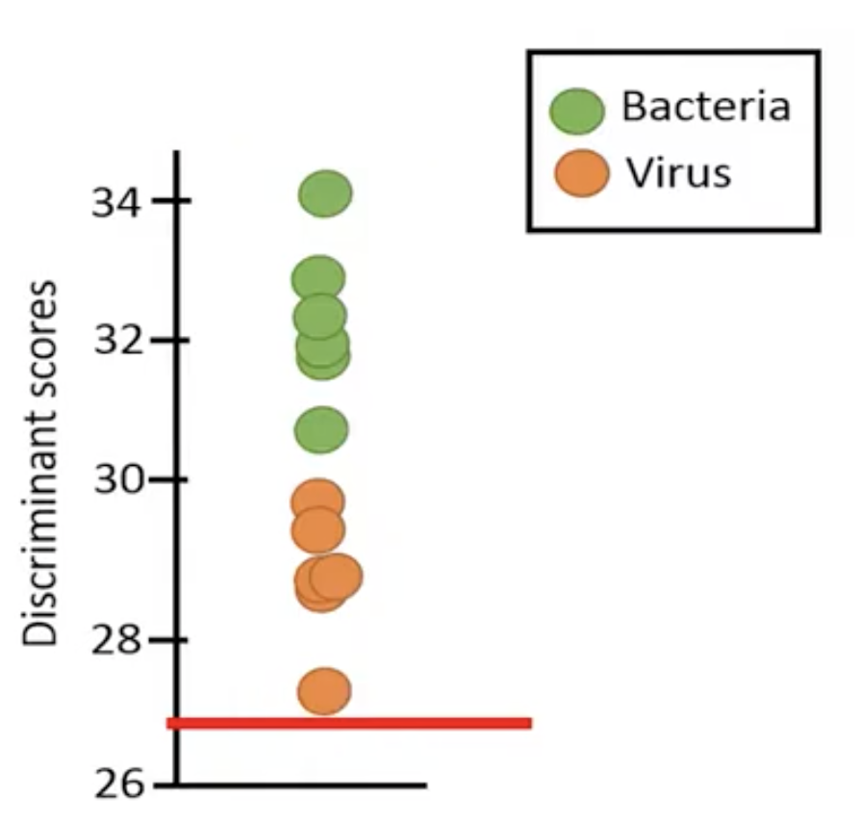
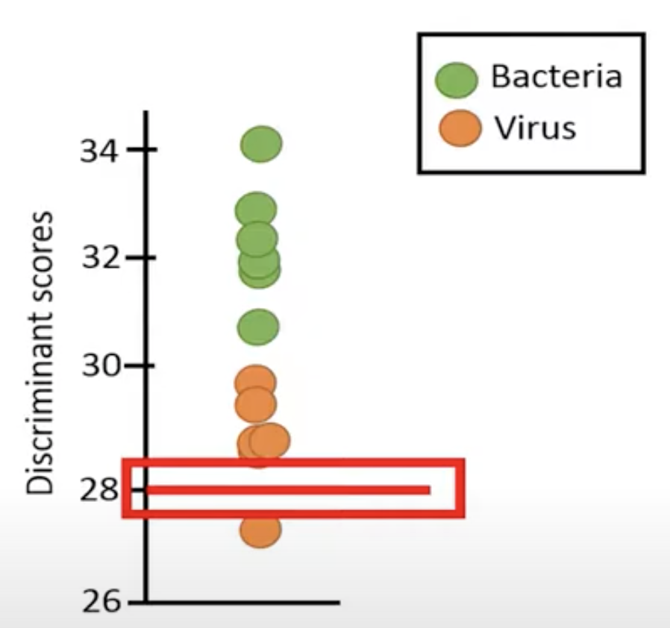
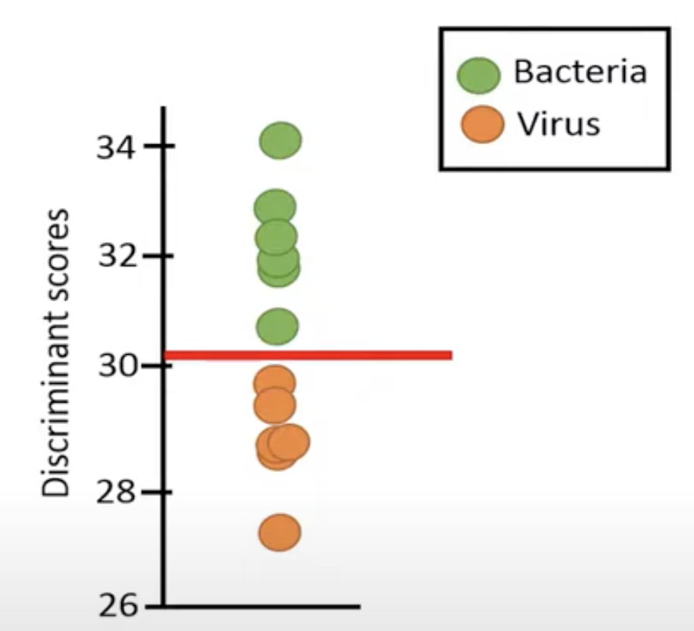
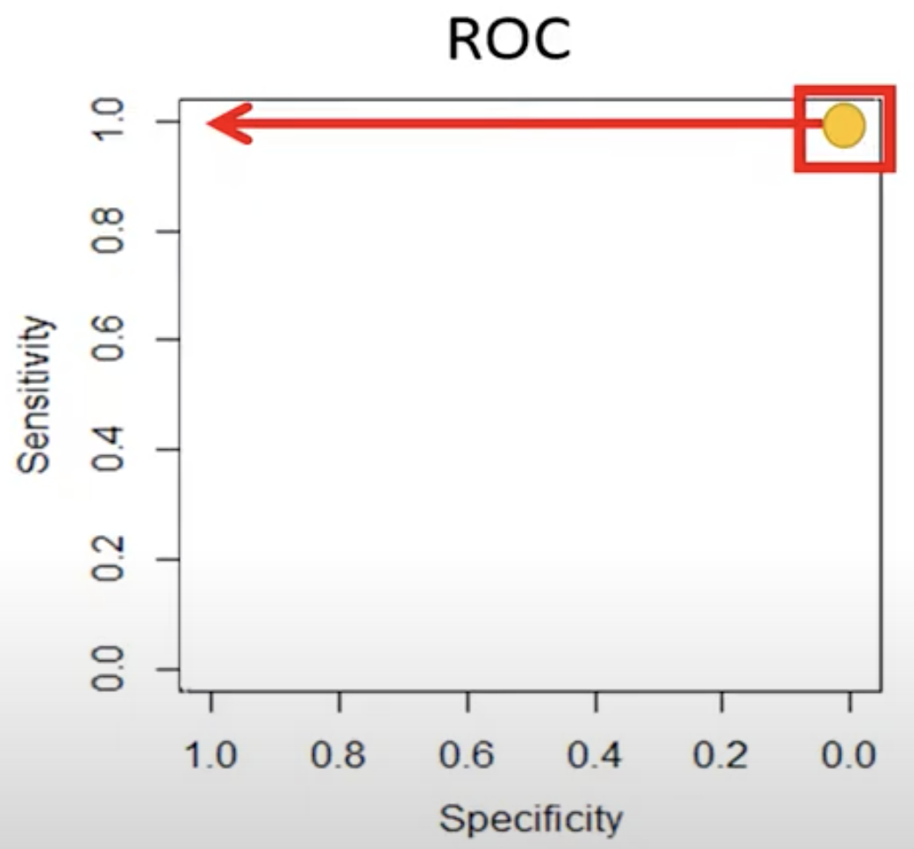
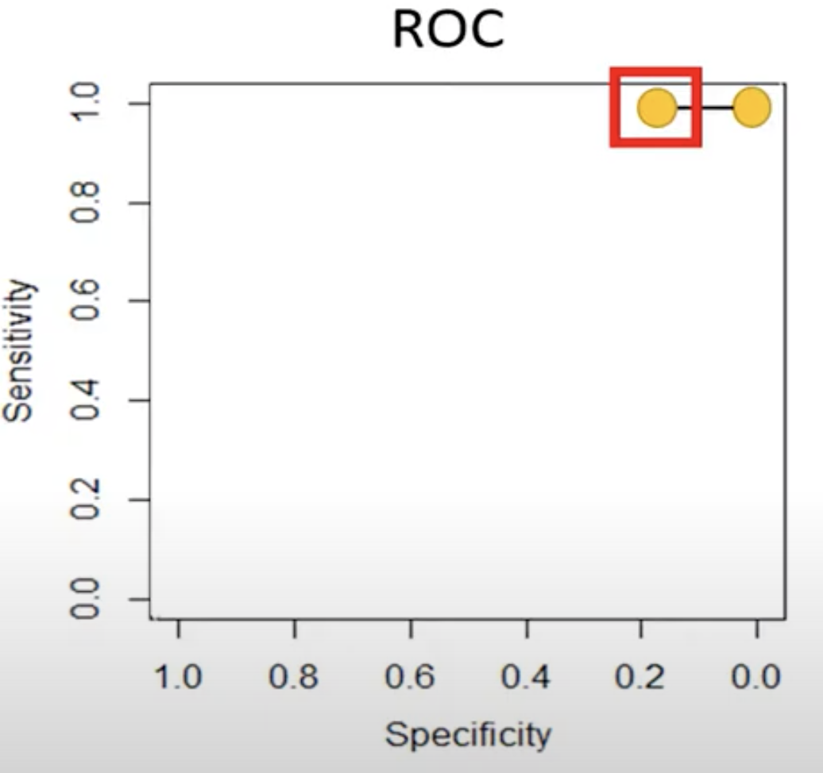
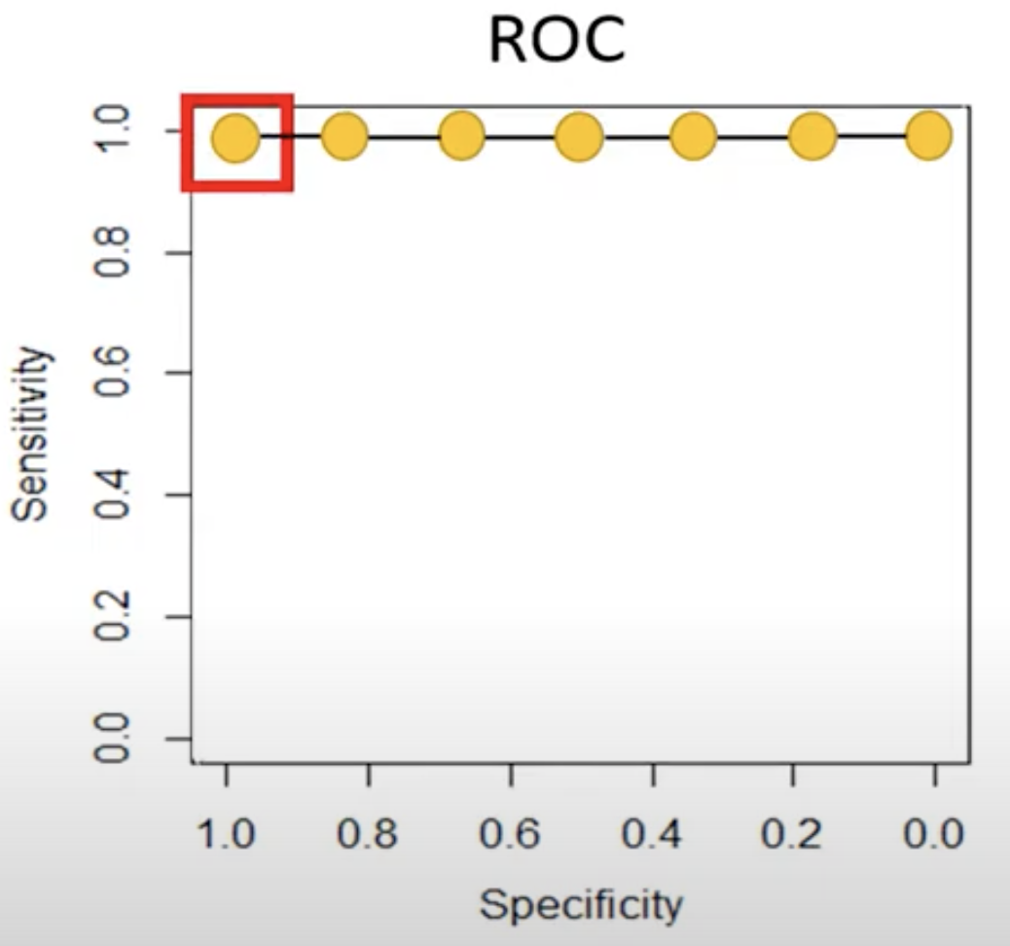
ROC curve
Notes:
We see how we can create an ROC curve based on the discriminant scores. Bu using a very low cutoff value, all individuals will be predicted to have a bacterial infection since they all have discriminant score great than the cutoff value. This will result in 100% sensitivity and 0% specificity. If we increase the cutoff value to 28, one of the individuals infected by a virus is correctly predicted to have a viral infection which increases the specificity from 0% to 17%. If we continue to increase the cutoff value, two of the individuals infected by a virus are now correctly predicted to have a viral infection, which increases the specificity from 17% to 100%. At this cutoff value, we get a complete separation between the groups which gives 100% sensitivity and 100% specificity.

Slide 15
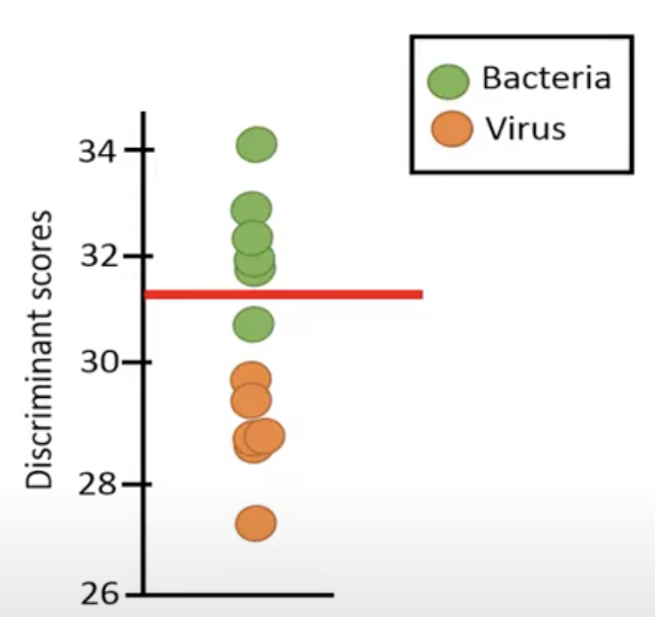
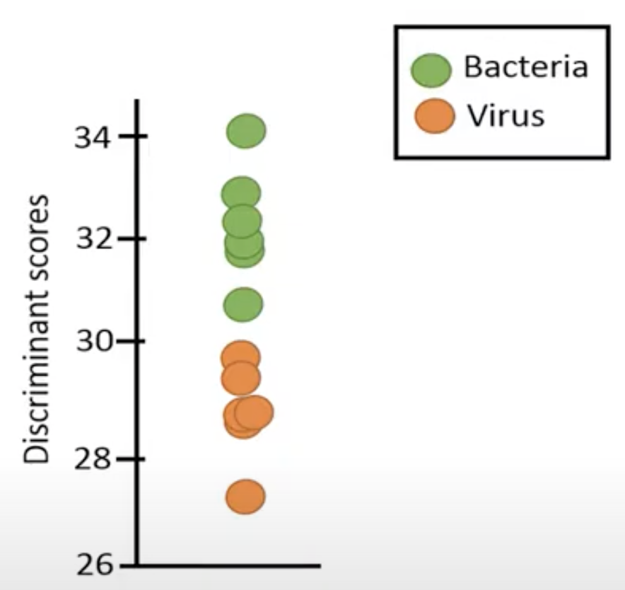
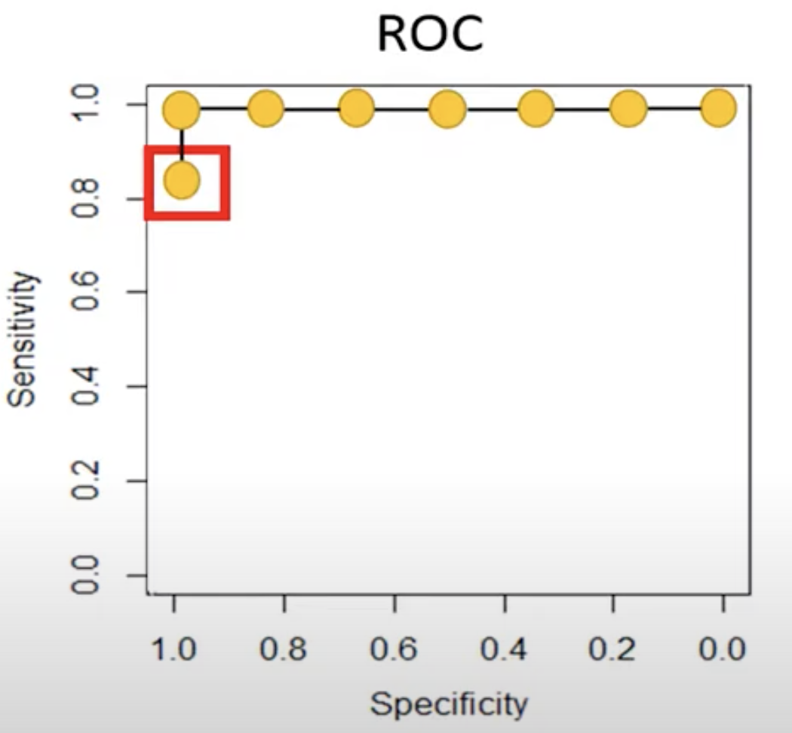
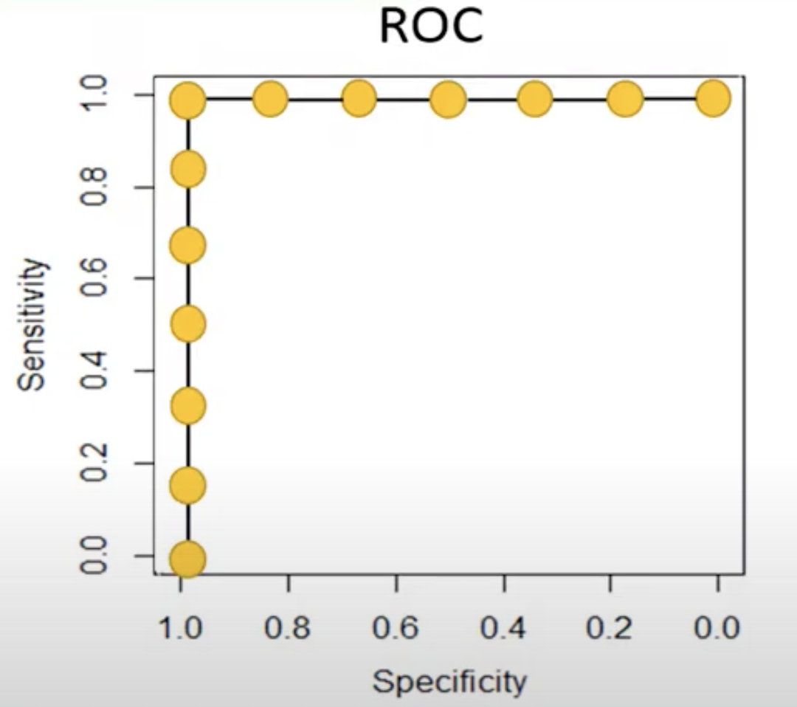
ROC curve
Notes:
If we continue to increase the cutoff value, the sensitivity is reduced from 100% to 83%. If we test all possible cutoff values, we can generate the full ROC curve.
Note that, since we have a complete separation between the groups, the area under the ROC curve is equal to 1.

Slide 16
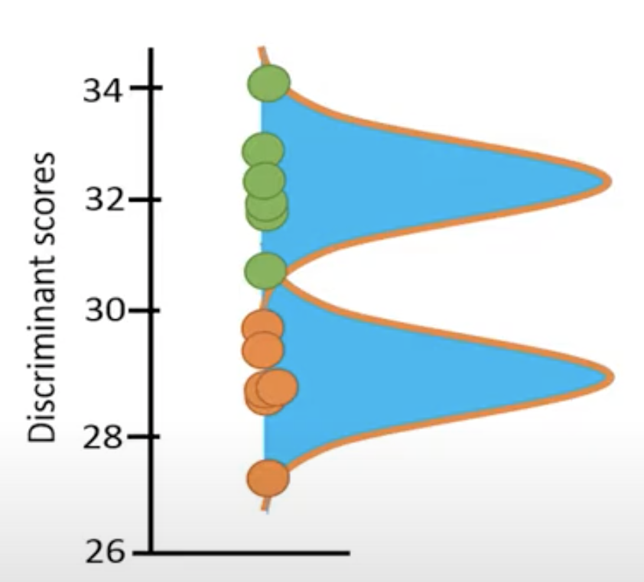
Probabilities
Probabilities are computed based on the heights of the two curves
Infection | CRP(mg/L) | Temp (C) | Scores | Probabilities
Viral | 40 | 36 | 29.5 | 0.023
Viral | 11.1 | 37.2 | 27.3 | 0.000
Viral | 30 | 36.5 | 28.8 | 0.002
Viral | 21.4 | 39.4 | 29.9 | 0.088
Viral | 10.7 | 39.6 | 28.9 | 0.003
Viral | 3.4 | 40.7 | 28.9 | 0.003
Bacterial | 42 | 37.6 | 30.8 | 0.695
Bacterial | 31.1 | 42.2 | 32.9 | 1.000
Bacterial | 50 | 38.5 | 32.3 | 0.997
Bacterial | 60.4 | 39.4 | 34 | 1.000
Bacterial | 45.7 | 38.6 | 31.9 | 0.990
Bacterial | 17.3 | 42.7 | 31.8 | 0.984
Notes:
We see how we can compute probabilities based on the discriminant scores.
These probabilities were calculated, they represent the probability of having a bacterial infection because we previously decided that the bacterial infection was associated with a positive test result. These probabilities can be computed by assuming that the scores are normally distributed. The shape and location of these two normal distribution curves are based on the pooled standard deviation and the mean scores of the two groups.
The curve for the viral group has a mean of 28.9 whereas the curve for the bacterial group has a mean of 32.3. These probabilities have been computed based on the heights of the two curves.
For example, a score of 30.8 results in a probability of 69.5% that this data point is of class bacterial.

Slide 17
Probabilities
Infection | CRP(mg/L) | Temp (C) | Scores | Probabilities | Predicted class
Viral | 40 | 36 | 29.5 | 0.023 | Viral
Viral | 11.1 | 37.2 | 27.3 | 0.000 | Viral
Viral | 30 | 36.5 | 28.8 | 0.002 | Viral
Viral | 21.4 | 39.4 | 29.9 | 0.088 | Viral
Viral | 10.7 | 39.6 | 28.9 | 0.003 | Viral
Viral | 3.4 | 40.7 | 28.9 | 0.003 | Viral
Bacterial | 42 | 37.6 | 30.8 | 0.695 | Bacterial
Bacterial | 31.1 | 42.2 | 32.9 | 1.000 | Bacterial
Bacterial | 50 | 38.5 | 32.3 | 0.997 | Bacterial
Bacterial | 60.4 | 39.4 | 34 | 1.000 | Bacterial
Bacterial | 45.7 | 38.6 | 31.9 | 0.990 | Bacterial
Bacterial | 17.3 | 42.7 | 31.8 | 0.984 | Bacterial
Notes:
By using these probabilities, we can see that a probability value less than 0.5 should result in that we classify the patient as having a viral infection, where as probability greater than 0.5 should be classified as a bacterial infection.

Slide 18
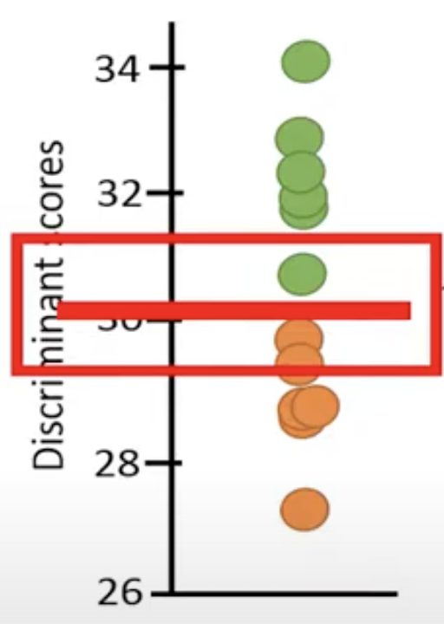
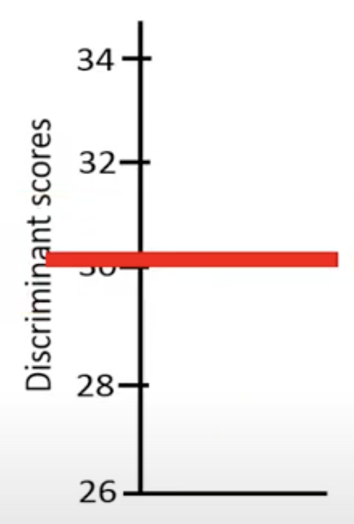
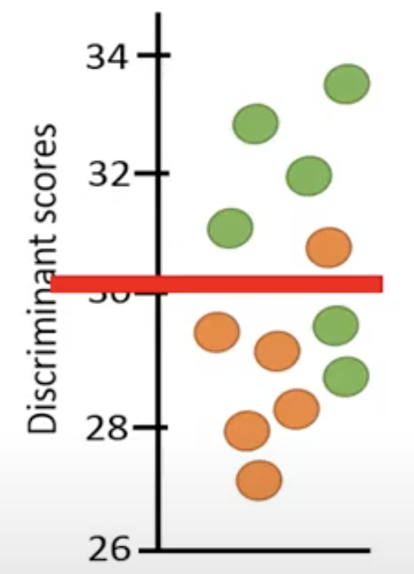
Validation
Split data into a training data and a testing data
Determine an appropriate cutoff value
Remove the training data
Use the test data to calculate the discriminant scores
Notes:
To validate the LDA, we could split data into a training data set and testing data set. Then we use the training data to compute the linear discriminant function. We determine an appropriate cutoff value. Next we remove the training data and use the test data to calculate the discriminant scores with the weights that were estimated based on the training data. Then we use these discriminant scores to compute metrics such as sensitivity, specificity and accuracy by using the given cutoff value we decided based on the training data.

Slide 19
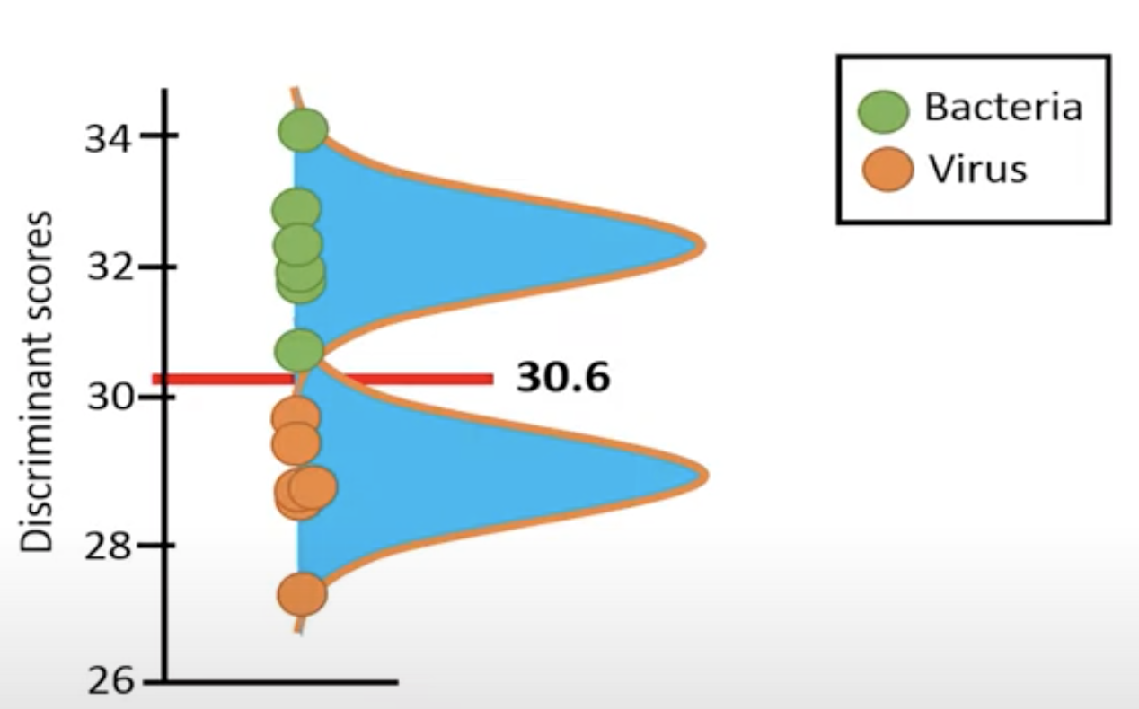
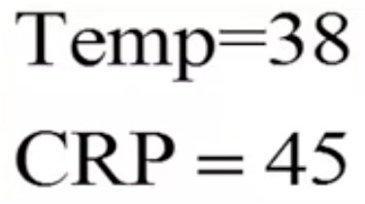
Predict
LD = 31.5
Predict that the person has a bacterial infection
Notes:
Once we have validated the model and decided on an appropriate cutoff value, we could use model to make prediction.
In this example we cutoff value of 30.6.
For example, if a person has a CRP value of 45 and Temp value of 38, we can predict the class based on our discriminant function. We have the discriminant score is 31.5, which is greater than the cutoff value of 30.6. we would predict that the person has a bacterial infection.

Slide 20
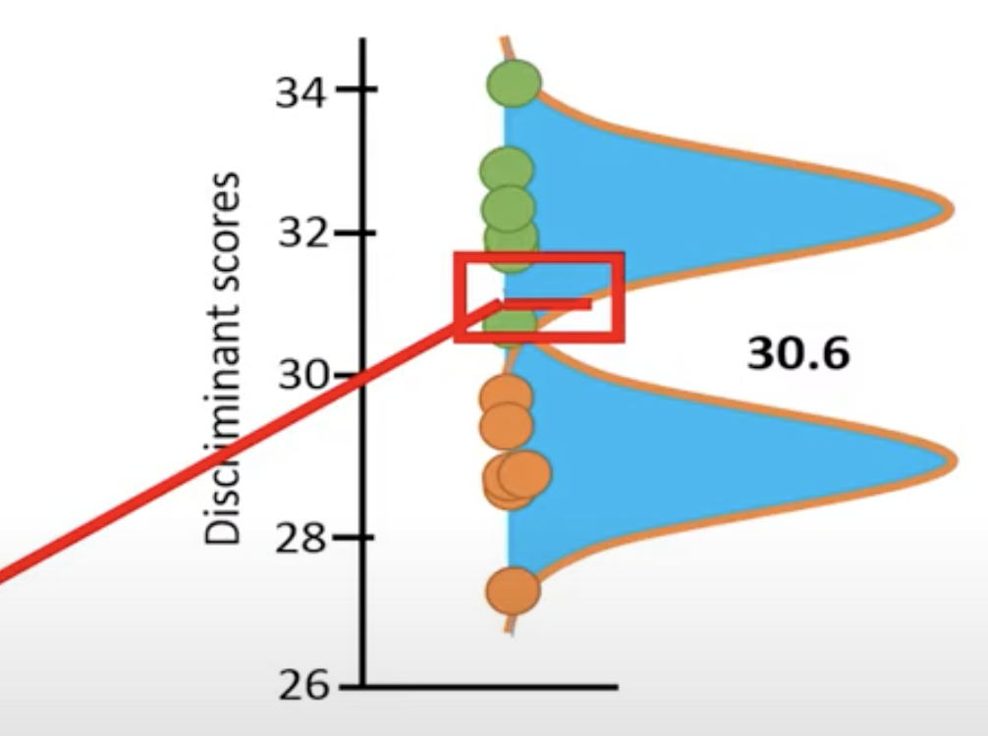
Predict
LD = 31.5
P (bacterial) = 0.95
Notes:
Based on the heights of the two normal distribution curves at the value 31.5, we can compute the probability for a bacterial infection to 95%

Slide 21
LDA
More than two group
Notes:
In comparison to, for example, logistic regression, LDA can be used with more than two groups

Slide 22

The Iris data set
Notes:
We see how we can use LDA to discriminate between the three species in the classical Iris flower data set. This data set consists of measurements of the sepal length, sepal width, petal length, and petal width. These 4 variables were measured on 50 setosas, 50 versicolors and 50 virginicas.

Slide 23
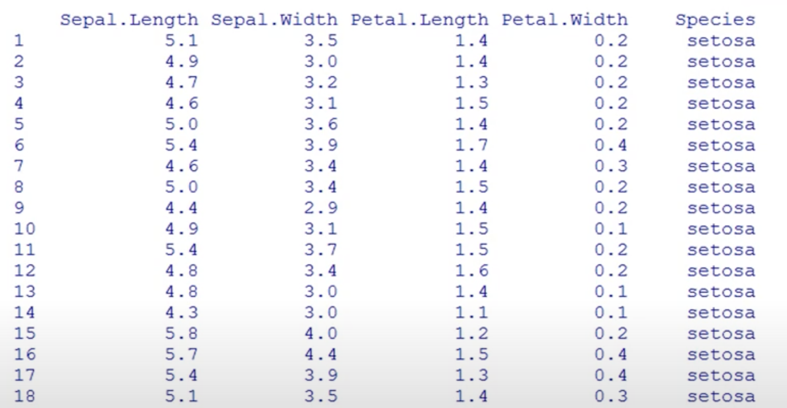
The Iris data set
Notes:
The data has 150 rows, where each row represents the measurements of one Iris flower. These columns show the sepal length and width, as well as the petal length and width in centimeters of the first 18 flowers in the Iris data set. The last column shows the three species: setosa, versicolor and virginica.

Slide 24
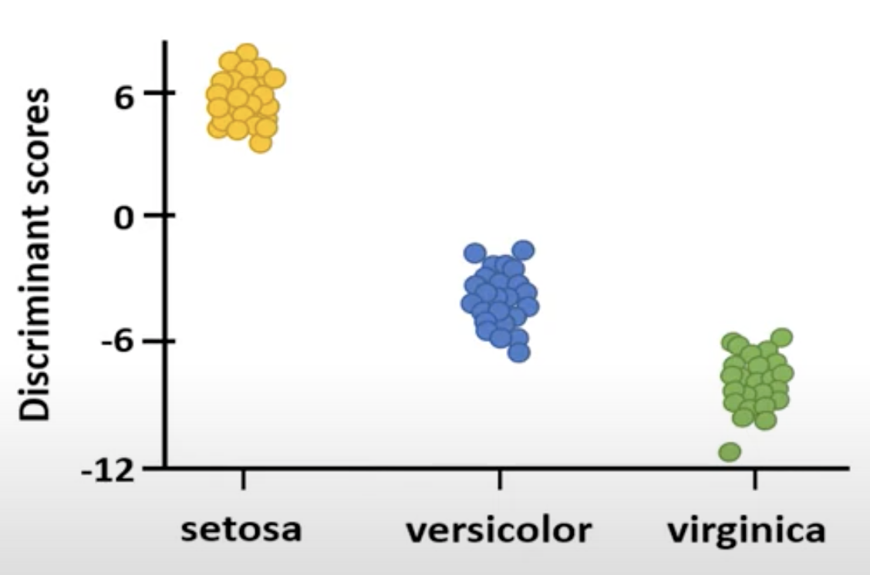
LDA
Notes:
By using a statistical software, the following weights were computed for the first discriminant function, which generates a maximal separation between the three groups, based on the sepal length, sepal width, petal length and petal width.
If we plot the discriminant scores of the first discriminant function for the 150 flowers, we see that the setosa flowers separate well from the other two species whereas there is some overlap in the scores between versicolor and virginica.

Slide 25
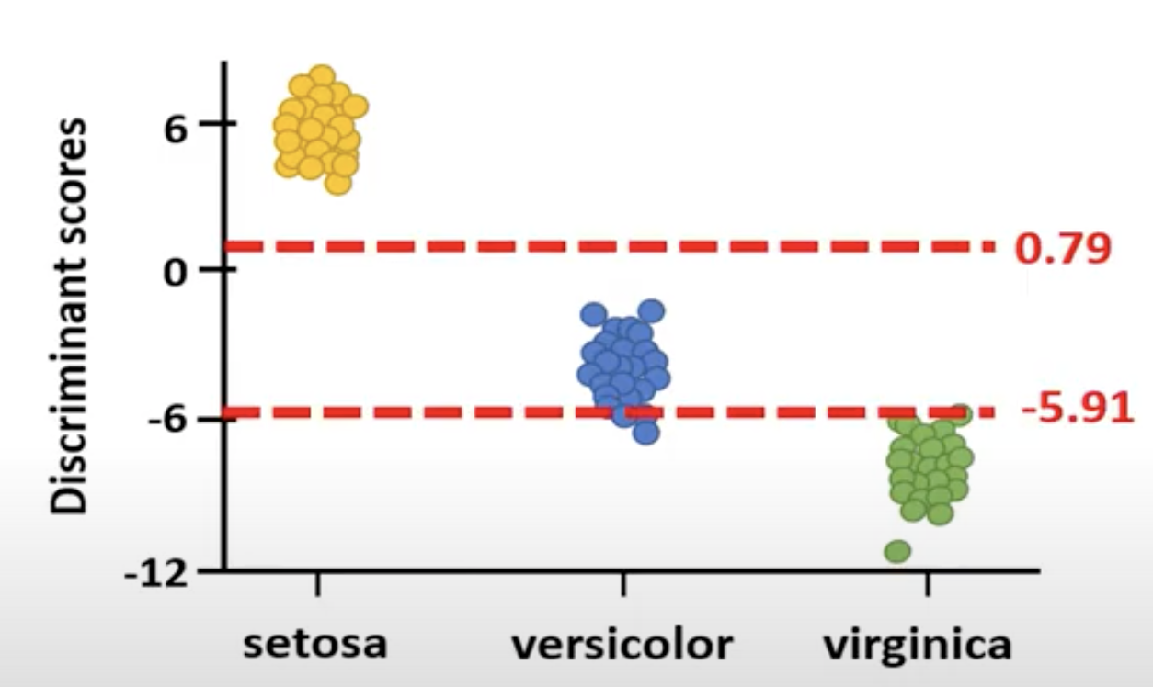
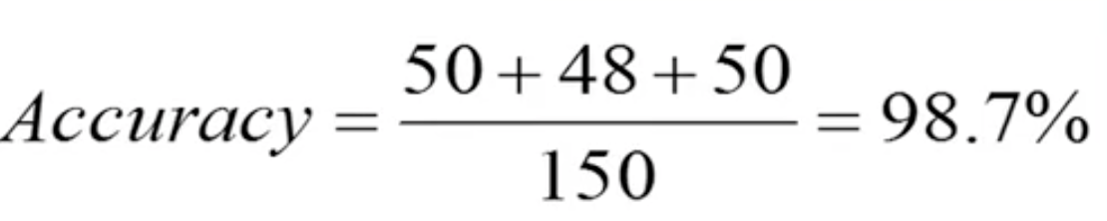
LDA - cutoff
Notes:
If we use the following cutoff values, based on the average of the means of the neighboring groups, then we see that all setosa and virginica flowers are correctly classified whereas two versicolors are predicted as virginicas.
Since we make 148 correct predictions out of 150, the accuracy of our classifier is 98.7%.

Slide 26
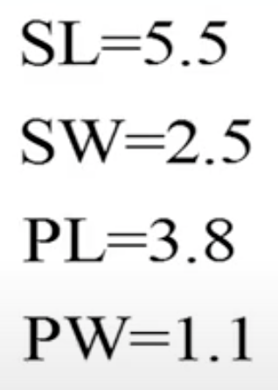
LDA - predict
Notes:
We use the linear discriminant function to make predictions. Suppose that we find an Iris flower that might either be a setosa, versicolor or virginica. To determine its species, we measure the sepal length and width, and the petal length and width in centimeters. Then we plug in the measurements in the equation and do the math. We see that the discriminant score is -3.1, is located between the two cutoff lines. The model predict that this Iris flower is a versicolor.

Slide 27

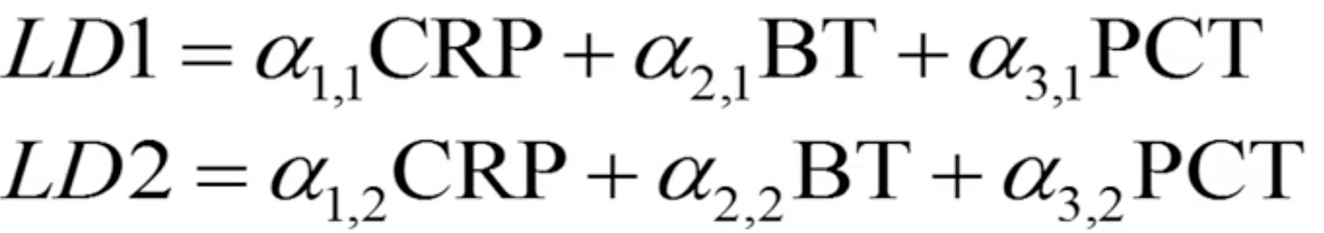
LDA – three groups
Infection | CRP(mg/L) | Temp (C) | PCT (ng/ml)
Viral | 40 | 36 | 1.1
Viral | 11.1 | 37.2 | 0.9
Viral | 30 | 36.5 | 10.1
Viral | 21.4 | 39.4 | 3.3
Viral | 10.7 | 39.6 | 3.8
Viral | 3.4 | 40.7 | 30.2
Bacterial | 42 | 37.6 | 9.8
Bacterial | 31.1 | 42.2 | 10.3
Bacterial | 50 | 38.5 | 27.8
Bacterial | 60.4 | 39.4 | 40.8
Bacterial | 45.7 | 38.6 | 30.9
Bacterial | 17.3 | 42.7 | 80.3
Parasitic | 40.2 | 40.3 | 20.1
Parasitic | 33.2 | 40.1 | 40.8
Parasitic | 20.3 | 38.3 | 30.2
Parasitic | 70.3 | 38.1 | 60.9
Parasitic | 28.3 | 37.2 | 9.2
Parasitic | 29.9 | 38.4 | 50.3
Notes:
Remember that we previously used LDA to classify bacterial and viral infections. If we use data on parasitic infections as well as on other clinical variables, such as the PCT concentration in blood then we could combine the variables and use the discriminant function to predict if someone has a viral, bacterial or parasitic infection. Since these three clinical variables can be measured within just an hour, an early decision can be made about how to treat the patients long before the actual type of infection can be determined, which usually takes days to confirm.
However, remember that we first need to validate our model before we use it for predictions.
Note that, when we have 3 groups, there will be two useful discriminant functions, and if we have 4 groups there will be three useful discriminant functions and so on. However, the first discriminant function generates the best separation, whereas the other discriminant functions don’t usually improve the separation that much, which is the reason why just one discriminant function is commonly used because it simplifies the predictions.

Slide 28
References
https://www.youtube.com/watch?v=julEqA2ozcA&t=538s

